Slide 1

Capstone Project - Car Accident Severity
By
KEERTHI PRAKASH

Slide 2
Introduction
Every year car accidents cause hundreds of thousands of deaths worldwide. According to a research conducted by the World Health Organization (WHO) there were 1.35 million road tra c deaths globally in 2016, with millions more sustaining serious injuries and living with long-term adverse health consequences.
For the final capstone project in the IBM certificate course, we want to analyze the accident “severity” in terms of human fatality, traffic delay, property damage, or any other type of accident bad impact. The data was collected by Seattle SPOT Traffic Management Division and provided by Coursera via a link. This dataset is updated weekly and is from 2004 to present. It contains information such as severity code, address type, location, collision type, weather, road condition, speeding, among others.
The target audiences of this study are those people who really care about the traffic records, especially in the transportation department. Also, we want to figure out the reason for collisions and help to reduce accidents in the future.

Slide 3
Data
The data was collected by Seattle SPOT Traffic Management Division and provided by Coursera via a link. There are 194,673 observations and 38 variables in this data set. Since we would like to identify the factors that cause the accident and the level of severity, we will use SEVERITYCODE as our dependent variable Y (Target Variable) , and try different combinations of independent variables X to get the result. Since the observations are quite large, we may need to filter out the missing value and delete the unrelated columns first. Then we can select the factor which may have more impact on the accidents such as weather, road condition, and light condition.
The target Data to be predicted under (SEVERITYCODE 1-prop damage 2-injury) label.

Slide 4
Feature Selection
For implementing the solution, I have used Github as a repository and running Jupyter Notebook to preprocess data and build Machine Learning models. Regarding coding, I have used Python and its popular packages such as Pandas, NumPy and Sklearn.
Once I have load data into Pandas Dataframe, used ‘dtypes’ attribute to check the feature names and their data types. Then I have selected the most important features to predict the severity of accidents in Seattle. Among all the features, the following features have the most influence in the accuracy of the predictions:
“WEATHER”,
“ROADCOND”,
“LIGHTCOND”

Slide 5
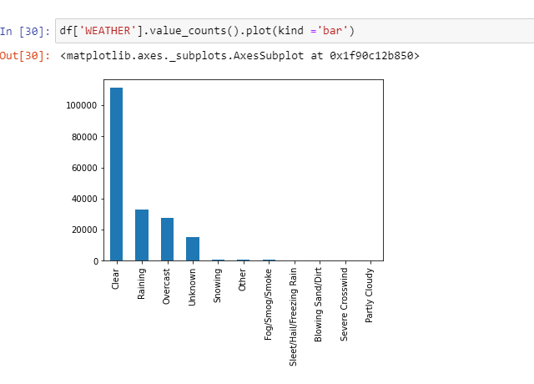
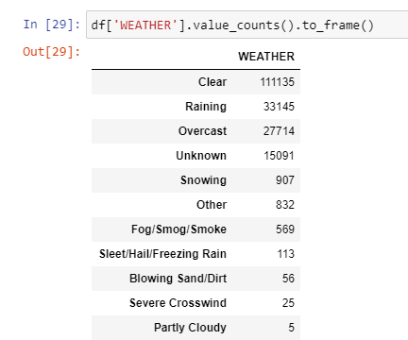
Weather Value Counts

Slide 6
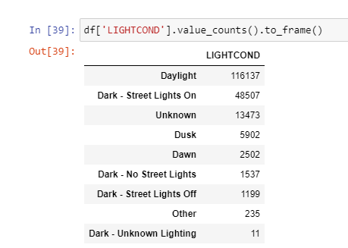
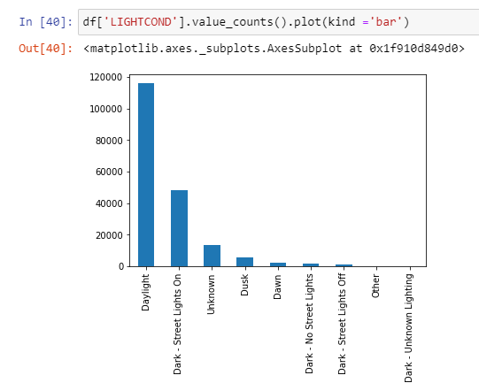
Light Conditions value counts

Slide 7
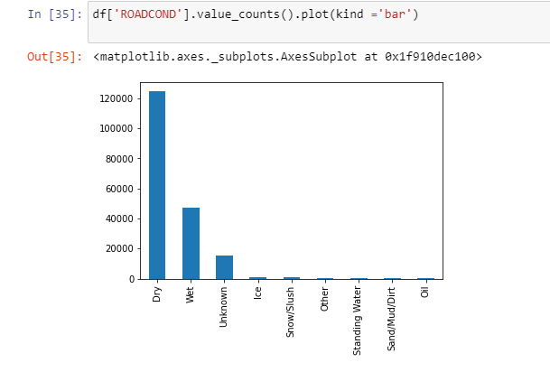
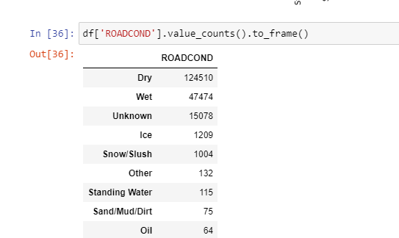
Road Conditions Value Counts

Slide 8
Data Preprocessing
The dataset in the original form is not ready for data analysis. In order to prepare the data, first, we need to drop the non-relevant columns. In addition, most of the features are of object data types that need to be converted into numerical data types.
After analyzing the data set, I have decided to focus on only four features, severity, weather conditions, road conditions, and light conditions, among others.
In it's original form, this data is not fit for analysis. For one, there are many columns that we will not use for this model. Also, most of the features are of type object, when they should be numerical type.
We must use label encoding to covert the features to our desired data type.

Slide 9

Resampling Data
To get a good understanding of the dataset, I have checked different values in the features. The results show, the target feature SEVERITYCODE is imbalance, so we use a simple statistical technique to balance it.
In fact, severitycode in class 1 is nearly three times the size of class 2.
We can fix this by downsampling the majority class.

Slide 10

Define X and y

Slide 11

Normalize the data

Slide 12
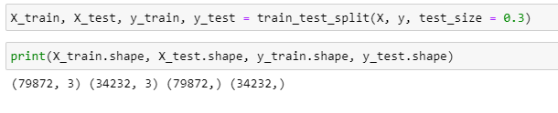
Splitting our Data Set into Training Data and Test Data
We will use 30% of our data for testing and 70% for training.

Slide 13
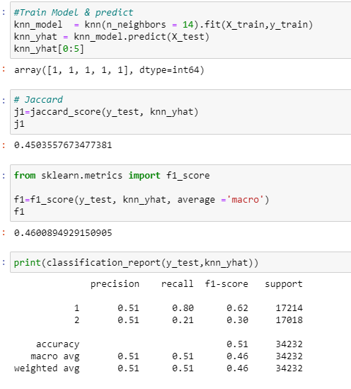
Methodology
KNN

Slide 14
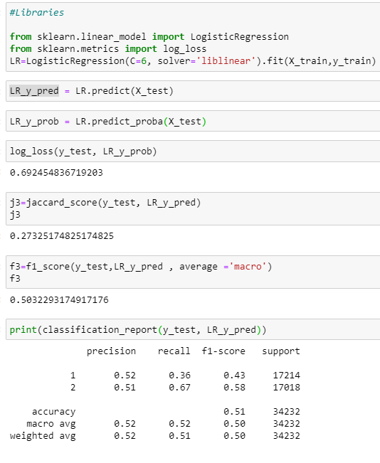
Decision Tree

Slide 15
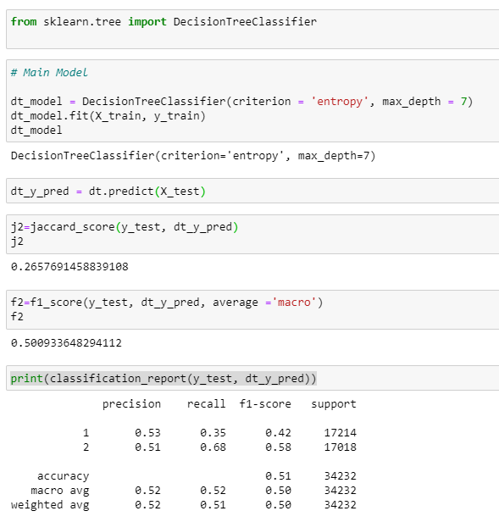
Logistic Regression

Slide 16
Evaluation
In the beginning of the notebook, we had categorical data that was of type 'object'. This is not a data type that we could have fed through an algoritim, so label encoding was used to created new classes that were of type int8; a numerical data type.
After solving that issue we were presented with another - imbalanced data. As mentioned earlier, class 1 was nearly three times larger than class 2. The solution to this was downsampling the majority class with sklearn's resample tool. We downsampled to match the minority class exactly with 58188 values each.
Once we analyzed and cleaned the data, it was then fed through three ML models; K-Nearest Neighbor, Decision Tree and Logistic Regression. The logistic regression, KNN, and SVM models have similar accuracy that we already seen in classification report. Although the first two are ideal for this project, logistic regression made most sense because of its binary nature.
Evaluation metrics used to test the accuracy of our models were jaccard score, f-1 score. Choosing different k, max depth and hyparameter C values helped to improve our accuracy to be the best possible.

Slide 17
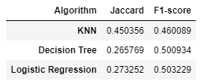
Evaluation

Slide 18
Conclusion
In this study, I analyzed the relationship between severity of an accident and some characteristics which describe the situation that involved the accident.I built and compared 3 different classification models to predict whether an accident would have a high or low severity. These models can have multiple application in real life.
Based on the dataset provided for this capstone from weather, road, and light conditions pointing to certain classes, we can conclude that particular conditions have a somewhat impact on whether or not travel could result in property damage (class 1) or injury (class 2).
By identifying the features that favor the most the gravity of an accident, these could be tackled by improving road conditions or increasing the awareness of the population.Furthermore, there are some places which has more accidents during the dark time. For those places, adding lights might be a good solution to reduce the collisions. Also, when more cars involved in the accident, it seems that the level of severity will increase. They may need to be responded immediately to save more life.

